Slide 1
Week 4 Report
By: Jacob Lin

Slide 2
Summary
Determined number of matched keypoints for GLM, ABI, and the matched pairs
Able to determine the coordinates of the keypoints
Learned:
Saimese Networks
Superglue
Superpoint
Ideas
Questions
Plan

Slide 3
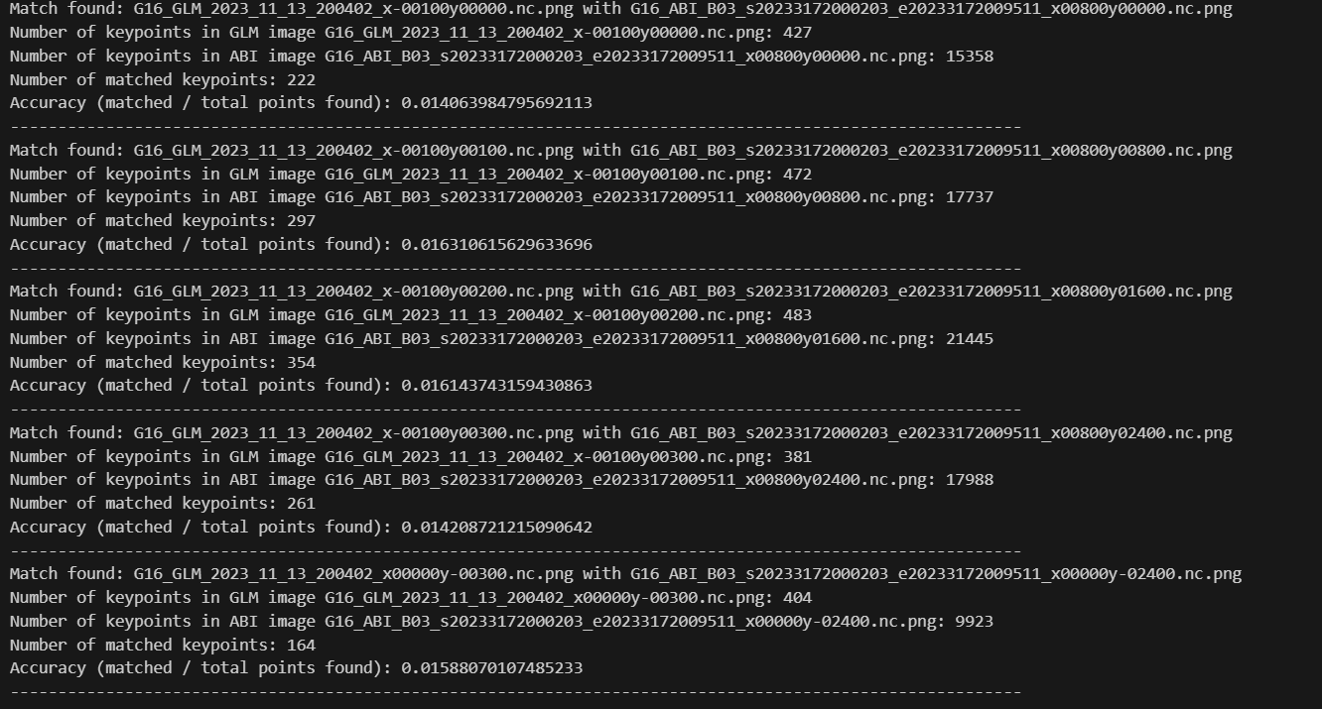
Determining number of matched points

Slide 4
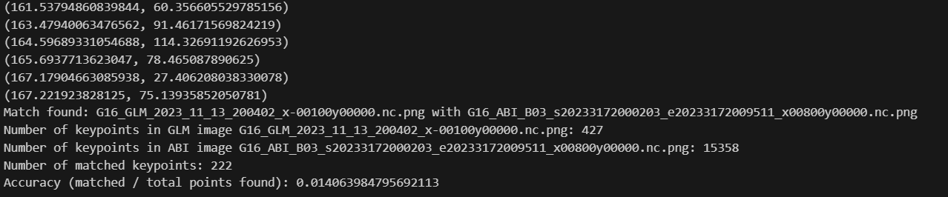
Getting the keypoint coordinates
Very easy to get the coordinates
Similarly same to get the paired coordinates

Slide 5
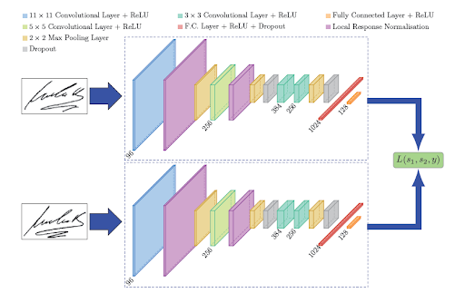
Siamese Networks
Used to find similarities between 2 images
Has 2 subnetworks, one for each image
Each subnetwork will have learned feature extraction
Uses distance instead of probability as outputs
Could be used

Slide 6
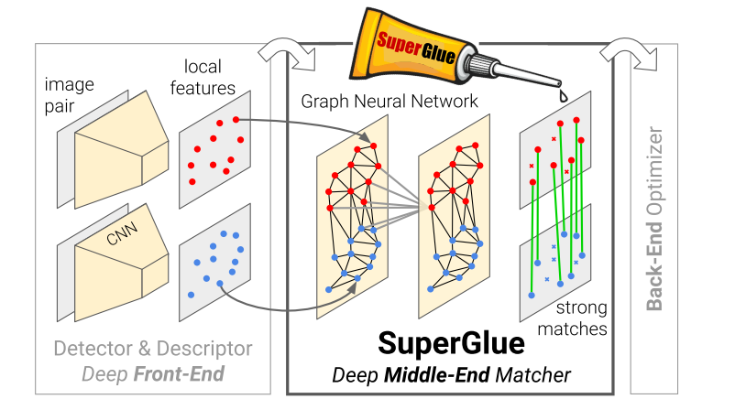
SuperGlue
Pretrained model
Works with SIFT!
Matched features of a image
Need to provide features using some sort of feature detection
Finds connection between the features
Really good for orientation and speed
Resource: https://github.com/magicleap/SuperGluePretrainedNetwork

Slide 7
Superpoint
Made by the creators of SuperGlue
Similar to SIFT
Generates key points within an image
Looks to be less

Slide 8
Idea
Use SIFT/SuperPoint to generate all key points within GLM & ABI
Use current correct matcher and extract all matched keypoints
Can verify by using the naming scheme of the files
Use Superglue to match keypoints

Slide 9
Questions
How to calculate accuracy?
Use another feature detector?
Final report rubric?
Timeline?

Slide 10
Next week!
Finalize neural network architecture
Prepare data

